Slide 1
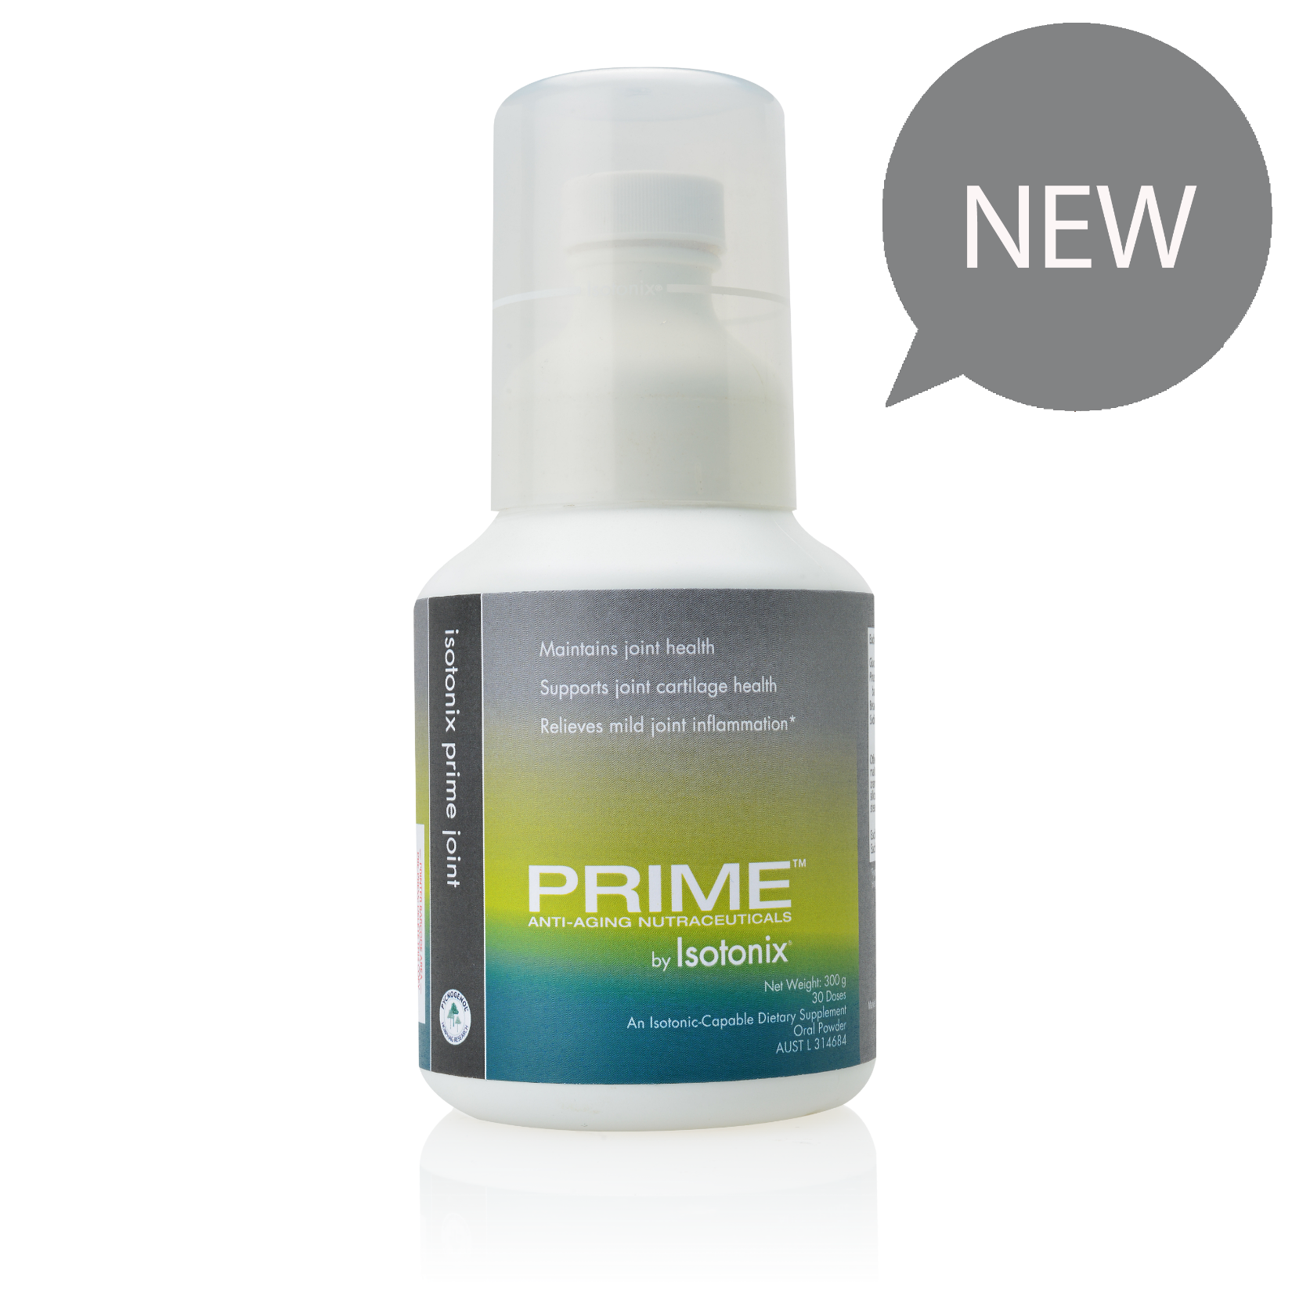
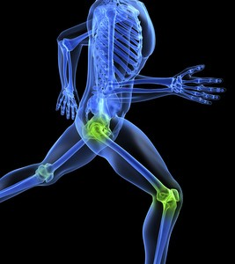
Prime™ Joint by Isotonix®

Slide 2
Understanding Bone and Joint Health
Joints are places where bones meet. Bones, muscles, ligaments and tendons all work together so that you can bend, twist, stretch and move about.
The ends of your bones are covered in a thin layer of a smooth tissue called cartilage. It acts like a slippery cushion that helps your joint move smoothly.
Around most of your joints is a joint capsule. This keeps your bones in place. Inside the capsule is a thick fluid which nourishes and lubricates your joint (like oil for a squeaky hinge).
Ligaments hold the joint together by joining one bone to another.
Your muscles are attached to the bones by tendons.
As your muscles contract, they pull on the bones to make the joint move.
Notes:
https://www.msk.org.au/arthritis/
To understand how arthritis and other musculoskeletal conditions work, it’s helpful to know a little about the muscles, bones and joints that make up your musculoskeletal system.

Slide 3
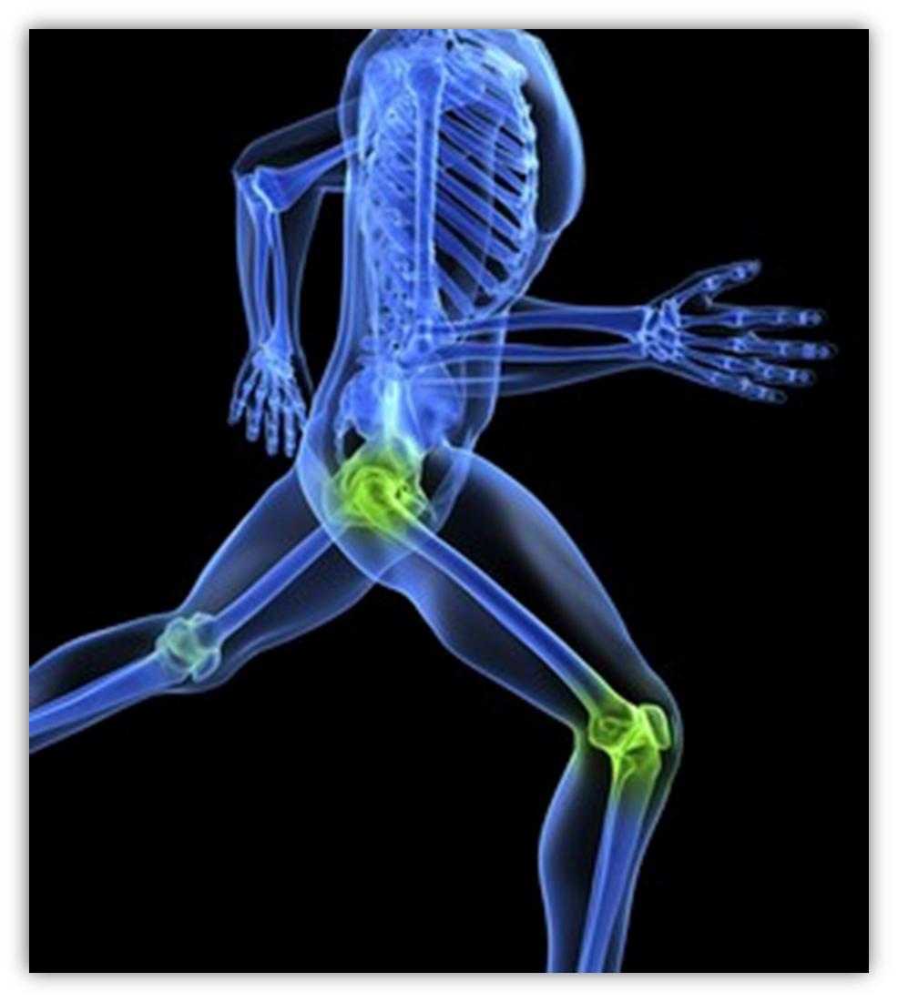
But, as you get older, cartilage starts to deteriorate from normal wear and tear. The body’s natural shock absorbers are wearing out, which means you begin feeling more of the physical toll your body is experiencing.
You may even notice that some joints have changed shape—especially in your fingers or toes. You may feel stiff in the morning, or have aches and pains in some joints that never bothered you before. The joint may even become sensitive to the touch.
These problems are common in older people. Usually, they are minor annoyances, but sometimes joint discomfort can make it very hard to function, and eventually they may need to have surgery or have the joint replaced.
Notes:
https://www.webmd.com/osteoarthritis/features/home-joint-care#1
https://www.betterhealth.vic.gov.au/health/conditionsandtreatments/rheumatoid-arthritis
http://www.drnickcampos.com/health-newsletter/Arthritis.html (image)

Slide 4
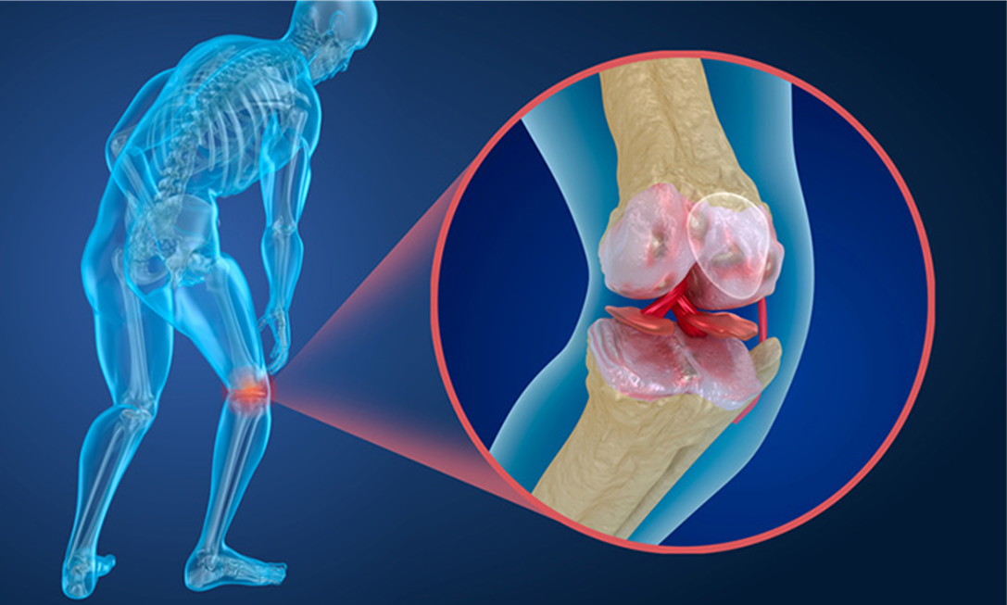
To understand how arthritis conditions work, it’s helpful to know a little about the muscles, bones and joints that make up your musculoskeletal system.
Arthritis affects the normal functioning of your joints, muscles, bones and surrounding structures.
Notes:
https://www.msk.org.au/arthritis/

Slide 5
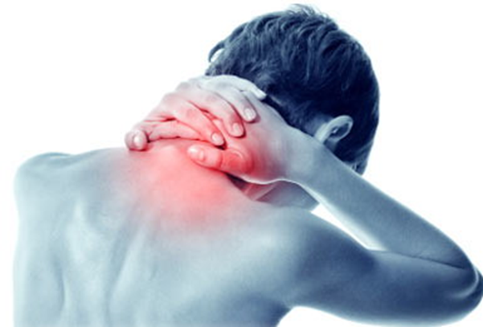
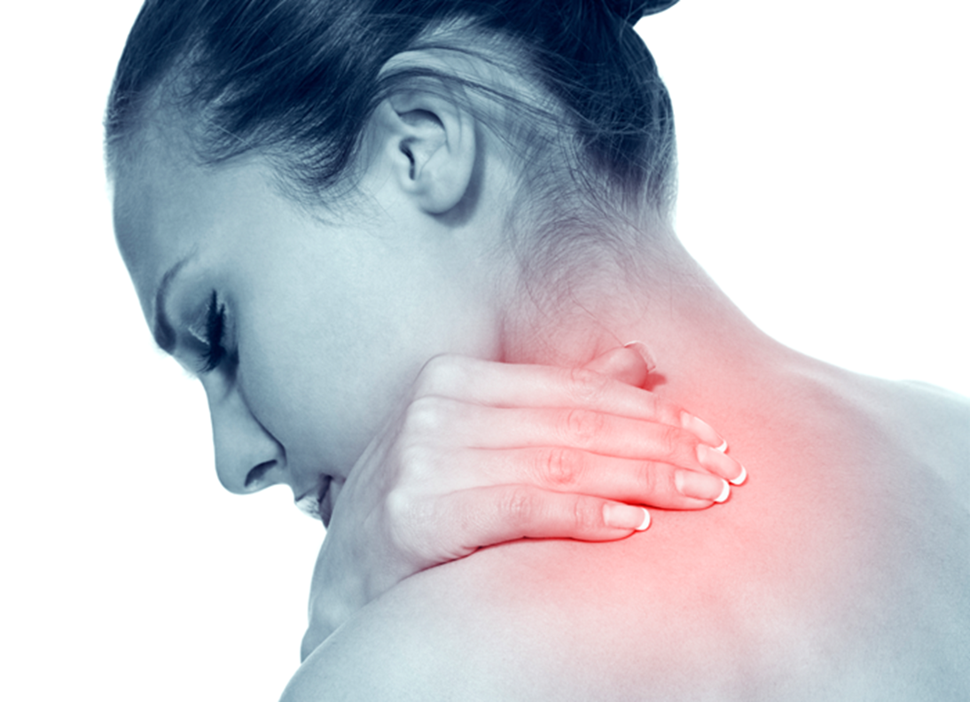
If you have swelling and stiffness every day, you're more likely to have damage than someone who has these symptoms less often.
Just as the tread on your tyres wears away over time, the cartilage that cushions your joints can break down, too.
Frayed cartilage can't heal or grow back.
"There's no way to reverse the arthritis once it has started," says Michaela M. Schneiderbauer, MD, Orthopedic Surgeon
Notes:
You can get damage even if you don't feel pain, but swelling in your joint is a reliable sign. So is a feeling of tenderness when you press on it
https://www.webmd.com/osteoarthritis/features/home-joint-care#1
https://www.webmd.com/rheumatoid-arthritis/guide/preventing-joint-damage-rheumatoid-arthritis

Slide 6
How common are arthritis and other musculoskeletal conditions?
Arthritis and other musculoskeletal conditions are very common, affecting around 1 in 3 (30%) Australians
Nearly 6.9 million people (30% of the total population) with arthritis and other musculoskeletal conditions
3.7 million (16%) had back pain and problems (the most common musculoskeletal condition)
3.5 million (15%) had arthritis and 801,000 (3.5%) had osteoporosis
3.9 million Australians have arthritis. That’s 1 in 6 people
Notes:
https://www.aihw.gov.au/getmedia/3eac4d13-fc92-4875-9bd9-df6ffe7e21ee/aihw-aus-221-chapter-3-10.pdf.aspx
https://www.arthritisnsw.org.au/about-arthritis/arthritis-statistics/

Slide 7
How common are arthritis and other musculoskeletal conditions?
By 2030, it is projected there will be 5.4 million Australians with arthritis
Around 2 million people with arthritis are of working age (15-64 years)
Arthritis health system is expected to rise to $7.6 billion by 2030
Arthritis is the leading cause of chronic pain and the second most common cause of disability and early retirement due to ill health in Australia
52,000 people (aged 15-64 years) unable to work due to arthritis
Notes:
https://www.arthritisnsw.org.au/about-arthritis/arthritis-statistics/

Slide 8
In one year there were more than 763,000 hospitalisations involving treatment and management of musculoskeletal conditions;
Osteoarthritis was the most common musculoskeletal reason for hospitalisation (accounting for 33% of all musculoskeletal hospitalisations)
Followed by back pain and problems (22%)
Other less common musculoskeletal reasons for hospitalisation were rheumatoid arthritis (1.7%)
Osteoporosis (1.1%), gout (1.0%) and juvenile arthritis (0.3%)
Notes:
https://www.aihw.gov.au/getmedia/3eac4d13-fc92-4875-9bd9-df6ffe7e21ee/aihw-aus-221-chapter-3-10.pdf.aspx

Slide 9
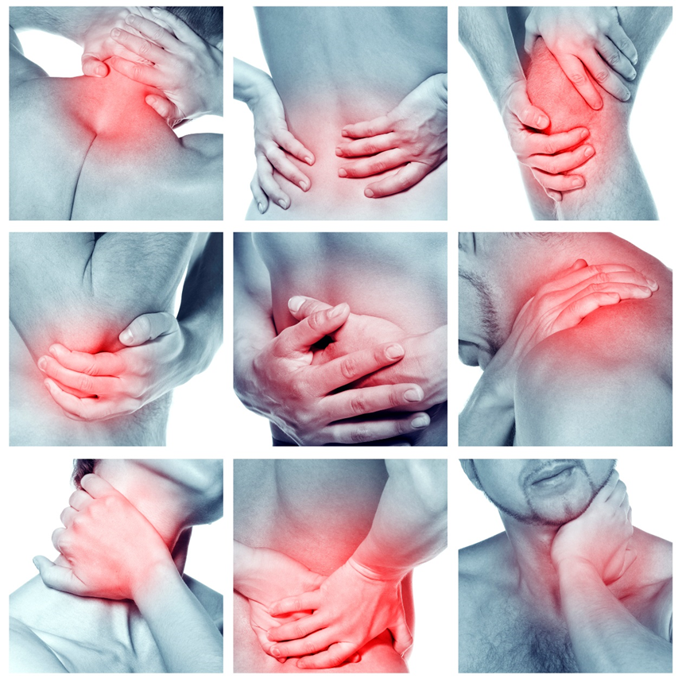
10 Signs You Need To look After Your Joints
You’re experiencing joint pain
Your joints are tender to touch
It takes you a while to get moving
You joints click, crack or grate when you move them
Your joints aren’t very flexible
You’re overweight
Your work has had an impact on your joints
You’ve participated in high impact exercise
You have a history of joint injury
Your parents had joint problems
Notes:
https://www.fusionhealth.com.au/news/chinese-medicine/10-signs-you-need-take-care-your-joints-and-what-do-about-them
How many of you have, or know someone that has, creaky, achy joints? Or a twinge in the knee? Maybe a sharp shooting pain from the shoulder to the elbow. No big deal, right?
Wrong. All too often, we assume joint pain is a normal part of aging and we just have to learn to live with. But nothing could be further from the truth. It's a serious problem, because pain can affect every aspect of your life.
Pain is not only the experience of hurting; it affects how you handle your life, your work, your interactions with family and friends. Chronic joint pain needs attention because it can impact so much of your life.

Slide 10
Factors that Aid in decreased bone and joint health
Increased Age
Excessive Weight
Genetics
Injury and overuse
Having A very physically demanding occupation
Notes:
Some factors that put stress on your joints are:
Excess weight. Being obese or overweight puts additional stress on joints, cartilage, and bones, especially those in the knees. It also means you’re less likely to be physically active.
Family history. Genetics may make a person more likely to develop poor joint health. If you have family members with poor joint health, you may be at an increased risk of developing it too.
Occupation. Certain occupations, such as those in construction, agriculture, cleaning, and retail, increase a person’s risk for developing joint discomfort. Their bodies are used more rigorously as part of their job, which means their joints are worked more and likely age faster than people who have a desk job.
Discomfort in the joints is an ongoing issue due to age, activity, weight, and other factors, so I feel this will always be a growing category. Consumers are looking for more natural ways to continue daily life activities more comfortably.
World­wide about 10% of men and 20 percent of women aged over 60 years have joint discomfort, which causes limitation in movement or, in severe cases, prevent one from performing daily activities.
These numbers continue to rise as the world population becomes more overweight and sedentary. And since participation in sports and other activities are often sporadic, stress and injury to joints is inevitable.
Therefore the supplements industry should experience a steady gain in the joint health sector, with a continued interest in new joint health products that are easy to take on a regular basis and that provide measurable benefits to the end consumer.

Slide 11
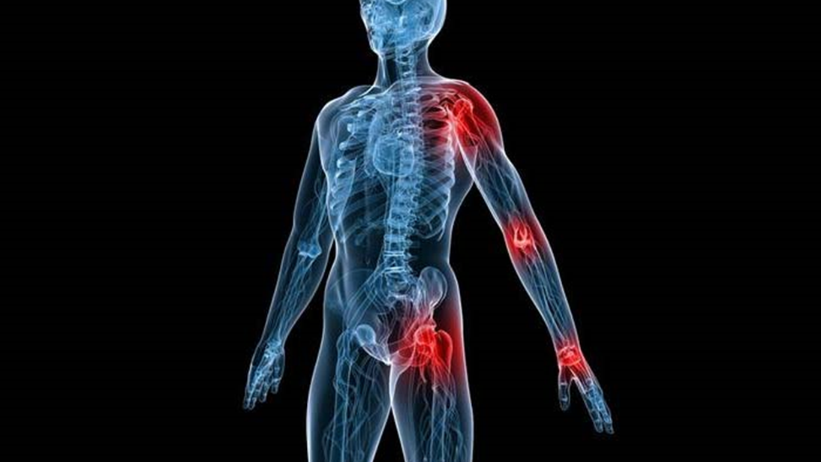
Bone & Joint Health: Common types of arthritis
Rheumatoid arthritis
Rheumatoid arthritis (RA), a common inflammatory form of arthritis, is an autoimmune disease that causes pain and swelling of the joints. In an autoimmune disease, your immune system starts attacking your own healthy tissues. In RA, the immune system targets the lining of the joints, causing inflammation and joint damage.
Osteoarthritis
Osteoarthritis is the most common form of joint disease. It affects the whole joint including bone, cartilage, ligaments and muscles. Although often described as ‘wear and tear’, this is not an accurate description of osteoarthritis. Osteoarthritis is now thought to be the result of a joint working extra hard to repair itself.
Gout
Gout is a common and painful condition that affects the joints. Small crystals form in and around the joint, causing inflammation, pain and swelling. An attack of gout usually comes on very quickly, often overnight. The joint becomes very red, swollen and extremely painful. Gout normally affects one joint at a time, often the joint of the big toe.
Notes:
https://arthritisaustralia.com.au/what-is-arthritis/types-of-arthritis/

Slide 12
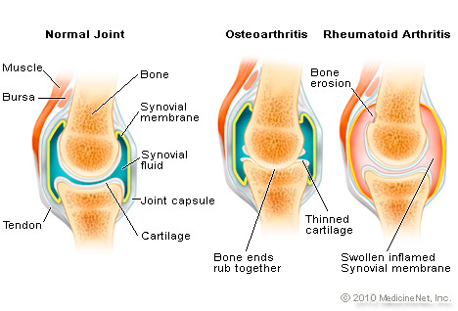
IMPACT OF ARTHRITIS
Notes:
Osteoarthritis is the most common form of joint disease. It affects the whole joint including bone, cartilage, ligaments and muscles. Although often described as ‘wear and tear’, this is not an accurate description of osteoarthritis. Osteoarthritis is now thought to be the result of a joint working extra hard to repair itself.
Rheumatoid arthritis (RA), a common inflammatory form of arthritis, is an autoimmune disease that causes pain and swelling of the joints. In an autoimmune disease, your immune system starts attacking your own healthy tissues. In RA, the immune system targets the lining of the joints, causing inflammation and joint damage.
https://arthritisaustralia.com.au/what-is-arthritis/types-of-arthritis/

Slide 13
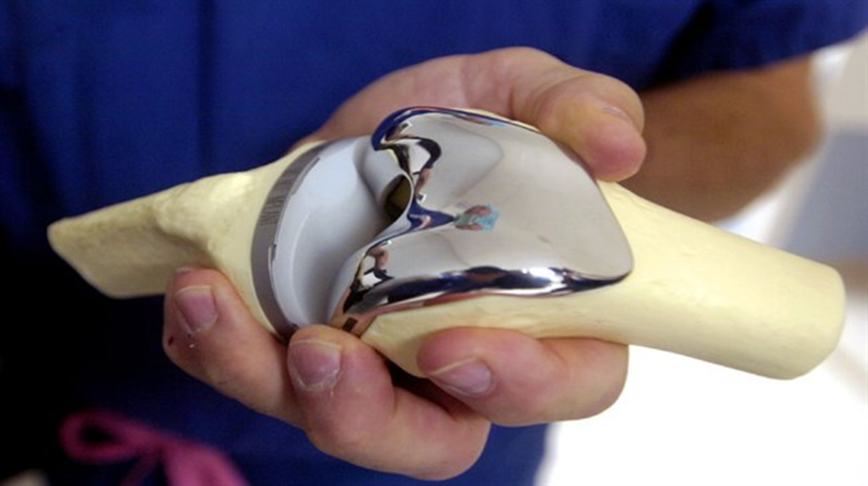
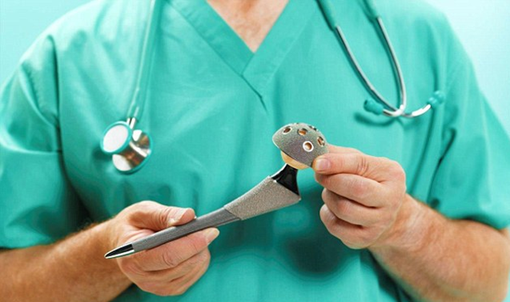
Joint replacement surgery is a common treatment for people with osteoarthritis who do not respond to medicines.
The rate of joint replacement surgery where osteoarthritis was the principal diagnosis increased by 36% for total knee replacements and 38% for total hip replacements.
Notes:
https://www.aihw.gov.au/getmedia/3eac4d13-fc92-4875-9bd9-df6ffe7e21ee/aihw-aus-221-chapter-3-10.pdf.aspx

Slide 14
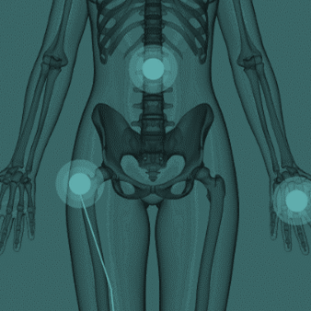
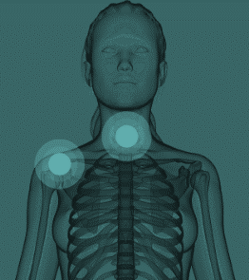
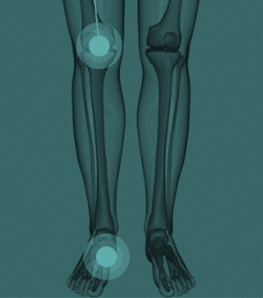
Arthritis pain can affect many areas of the body
Neck
Knees
Shoulders
Ankles and Feet
Back
Hips
Wrist and Hands
Notes:
https://arthritisaustralia.com.au/what-is-arthritis/areas-of-the-body/
Areas of the body
Arthritis and musculoskeletal pain can affect many areas of the body:
Neck
Pain that is felt in the upper part of the spine is common and is rarely due to serious disease. Staying active will help you get better faster and prevent more problems.
Shoulders
Pain that is felt in the shoulder area, at the top of the arm, is common and is rarely due to serious disease. Staying active will help you get better faster and prevent more problems.
Back
Pain that is felt in the lower part of the spine is common but is rarely due to serious disease. Staying active will help you get better faster and prevent more problems.
Wrists & hands
Any joint in your fingers, thumbs, knuckles and wrists can be affected by arthritis. Many different types of arthritis can affect your hands and cause joint pain, swelling and stiffness. Find out about aids and equipment that can make everyday tasks easier. Learn ways to protect your hands and manage your symptoms.
Hips
Hips are common places to develop arthritis, especially osteoarthritis. There are many treatments for osteoarthritis of the hip that may be helpful such as weight loss, exercise, medicines, aids or supports, heat and cold and many others.
Knees
Knees are common places to develop arthritis, especially osteoarthritis. There are many treatments for osteoarthritis of the knee that may be helpful such as weight loss, exercise, medicines, aids or supports, heat and cold and many others.
Ankles & feet
Any joint in your ankles, feet and toes can be affected by arthritis. Many different types of arthritis can affect the feet and cause joint pain, swelling and stiffness. Find out about aids and equipment that can make everyday tasks easier. Learn ways to protect your hands and manage your symptoms.

Slide 15
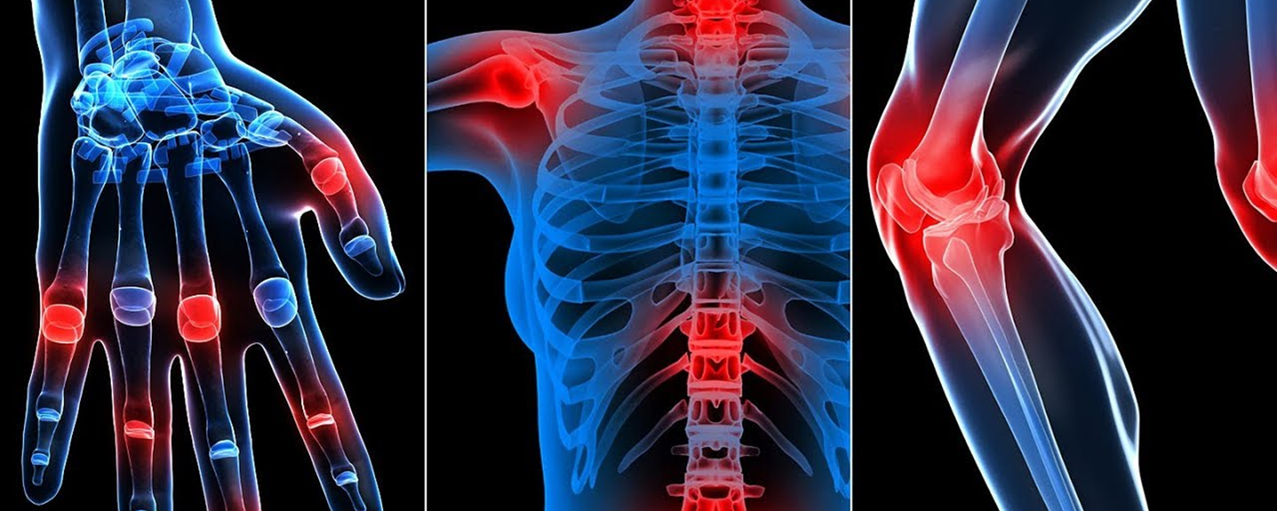
CAN ARTHRITIS BE TREATED?
Many types of arthritis can be easily and effectively controlled by modern treatment.
Early diagnosis and the right treatment can ease symptoms and may even prevent damage to your joints.
Because arthritis affects people in different ways, treatment has to be tailored to the needs of each person.
Notes:
https://www.arthritisnsw.org.au/about-arthritis/understanding-arthritis/

Slide 16
TAKING CARE OF YOUR JOINTS
Warm up
To keep it running smoothly and for optimal joint safety, start slowly and get up to speed only after your muscles and joints have at least five minutes prep time.
Exercise
Exercise can help you lose extra kilos and maintain a healthy weight. Some research suggests that aerobic exercise -- activities that get your heart rate up -- can reduce joint swelling.
Build Muscles to Support Joints
Strong muscles support your joints. If you don't have enough muscle, your joints take a pounding, especially your spine, hips, and knees, which must support your entire body weight. Weight training exercises help build muscle and keep your muscles and surrounding ligaments strong. That way, your joints don't have to do all the work.
Notes:
https://www.webmd.com/arthritis/caring-your-joints#1
https://www.arthritis.org/living-with-arthritis/pain-management/joint-protection/joint-health.php
Be good to your joints

Slide 17
TAKING CARE OF YOUR JOINTS
Enjoy a massage
Massage can relieve muscle tension and help reduce fatigue. Certain forms of massage, such as Swedish, focus on muscles and joints to improve function.
Eating Right Nourishes Joints
Eating a healthy diet is good for your joints, because it helps build strong bones and muscles.
Supplement
Glucosamine, has been shown to ease joint pain and stiffness, particularly in people with osteoarthritis of the knee. Some studies suggest that it may contribute to cartilage repair.
Notes:
https://www.webmd.com/arthritis/caring-your-joints#1
https://www.arthritis.org/living-with-arthritis/pain-management/joint-protection/joint-health.php
Be good to your joints

Slide 18
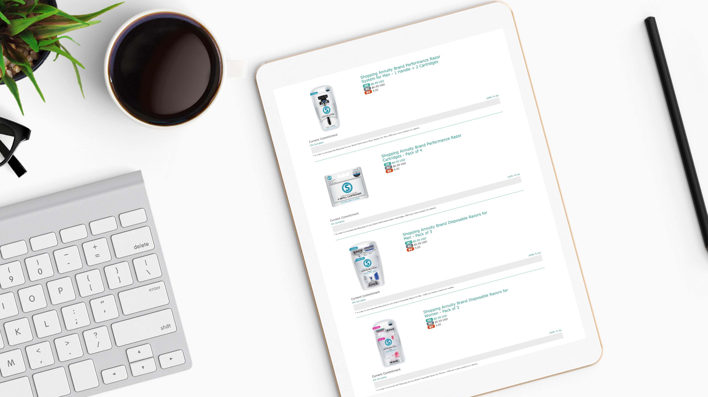
Unlike many niche companies that live or die by the success of one product, we are able to offer high-quality, exclusive brands across numerous multibillion-dollar markets.
The company will always provide the most popular products. This flexibility ensures stability, profitability and most importantly, longevity.
Notes:
https://www.marketamerica.com/site/product
Rather than being vulnerable to market swings, the company doesn't manufacture any one product or specialize in a single service. This concept, product brokerage, allows us to swing with the marketplace and capitalize on current consumer demands.
Every year, new products and product lines are being created to stay ahead of the competition. We invest in long-term relationships with manufacturers that will produce consistent quality products from year to year. As product brokers, we store limited quantities of products at any given time, which cuts down on consumer cost and ensures the freshest potency.

Slide 19
INTRODUCING……

Slide 20
Prime™ Joint by Isotonix®
Notes:
How many of you have, or know someone that has, creaky, achy joints? Or a twinge in the knee? Maybe a sharp shooting pain from the shoulder to the elbow. No big deal, right?
Wrong. All too often, we assume joint pain is a normal part of aging and we just have to learn to live with. But nothing could be further from the truth. It's a serious problem, because pain can affect every aspect of your life.
Pain is not only the experience of hurting; it affects how you handle your life, your work, your interactions with family and friends. Chronic joint pain needs attention because it can impact so much of your life.

Slide 21
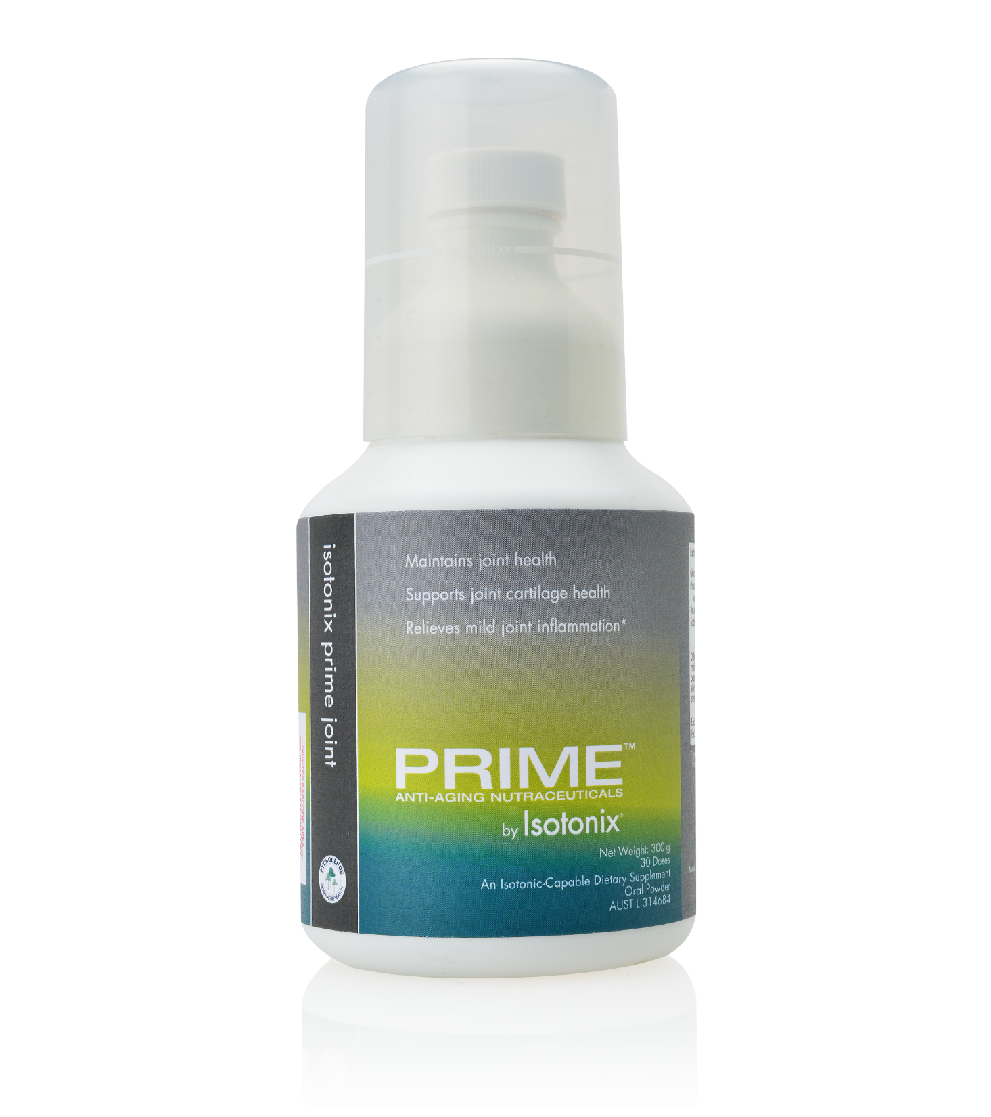
Only product on the market delivering glucosamine, with the powerful antioxidant Pycnogenol®† in isotonic form
Our exclusive solution for promoting optimal joint health
Notes:
Isotonix Prime Joint

Slide 22
This winning combination of proven ingredients supports and helps maintain optimal joint health, cartilage and inflammation:
Glucosamine
Supports healthy joint function and promotes the normal production of synovial fluid, which lubricates your joints and regenerates cartilage. Glucosamine is not readily available from food sources, making supplementation ideal for glucosamine needs.
Pycnogenol
Inhibits the body’s overactive inflammatory processes and supports relief from temporary inflammation associated with daily activities and the normal aging process. Pycnogenol® is highly bioavailable to the body, making it easily absorbed, according to studies.

Slide 23
Glucosamine
Glucosamine is a molecule that is naturally synthesised in the body from glucose and the amino acid glutamine.
Glucosamine is an important constituent of glycosaminoglycans in cartilage matrix and synovial fluid.
As our bodies age, we are less able to produce glucosamine, resulting in cartilage that is less flexible and weak.
Studies have shown that glucosamine supplementation can support normal, healthy cartilage cell production to help maintain overall joint health.

Slide 24
Pycnogenol
Pycnogenol is a water-soluble flavonoid complex with powerful benefits.
Numerous studies have examined the anti-inflammatory properties of Pycnogenol. The body’s inflammatory response is a natural process. It is an essential component of the body’s defense system, and can be triggered from numerous internal and external factors.
Pycnogenol has been shown help maintain the body’s natural defenses by inhibiting over active inflammatory responses associated with the normal aging process. Research has shown that Pycnogenol may inhibit the activation of NF-kappa B and AP-1, both of which are proinflammatory mediators.
Pycnogenol supplementation can also promote normal COX-2 and 5-LOX gene expression and support healthy leukotriene biosynthesis.
In addition, studies have shown the ability of Pycnogenol to cross-link collagen fibres and strengthen connective tissue proteins.

Slide 25
Additional Benefits:
Ideal for men and women with an active lifestyle and/or aging.
Maintains joint health
Supports joint cartilage health
Relieves mild joint inflammation*
Does not contain chondroitin (very poor absorption due to its high molecular weight and has inconclusive research)
Does not contain MSM. Research on MSM is also inconclusive, and it take large quantities (2-6 grams) daily for effects to become noticeable.
Notes:
*If symptoms persist, seek the advice of a healthcare professional.

Slide 26
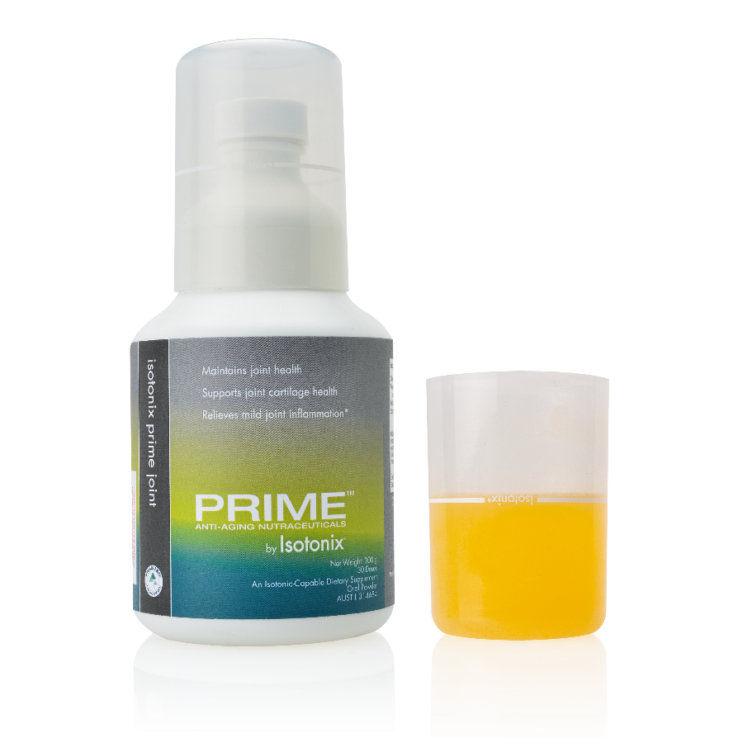
Isotonix - The world’s most advanced nutraceuticals
Isotonix dietary supplements are delivered in an isotonic solution. This means that the body has less work to do in obtaining maximum absorption. The isotonic state of the suspension allows nutrients to pass directly into the small intestine and be rapidly absorbed into the bloodstream. With Isotonix products, little nutritive value is lost, making the absorption of nutrients highly efficient while delivering maximum results.
Notes:
Isotonic, which means “same pressure,” bears the same chemical resemblance of the body’s blood, plasma and tears. All fluids in the body have a certain concentration, referred to as osmotic pressure. The body’s common osmotic pressure, which is isotonic, allows a consistent maintenance of body tissues. In order for a substance to be absorbed and used in the body’s metabolism, it must be transported in an isotonic state.

Slide 27
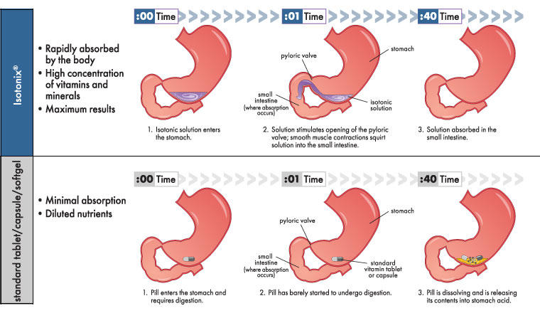
Delivery System
Notes:
Isotonic, which means “same pressure”, bears the same chemical resemblance of the body’s blood, plasma and tears. All fluids in the body have a certain concentration, referred to as osmotic pressure. The body’s common osmotic pressure, which is isotonic, allows a consistent maintenance of body tissues. In order for a substance to be absorbed and used in the body’s metabolism, it must be transported in an isotonic state.

Slide 28
How should Isotonix Prime Joint be taken?
Pour 3 level, white bottle capfuls (9.99 g) of powder into a cup.
Add 180 mL of water and stir for 1 dose. Line on the overcap indicates 60 mL.
Drink immediately after mixing is complete.
Notes:
As a dietary supplement, take once daily or as directed by your healthcare provider. Maximum absorption occurs when taken on an empty stomach. This product is isotonic only if the specified amounts of water and powder are used.

Slide 29
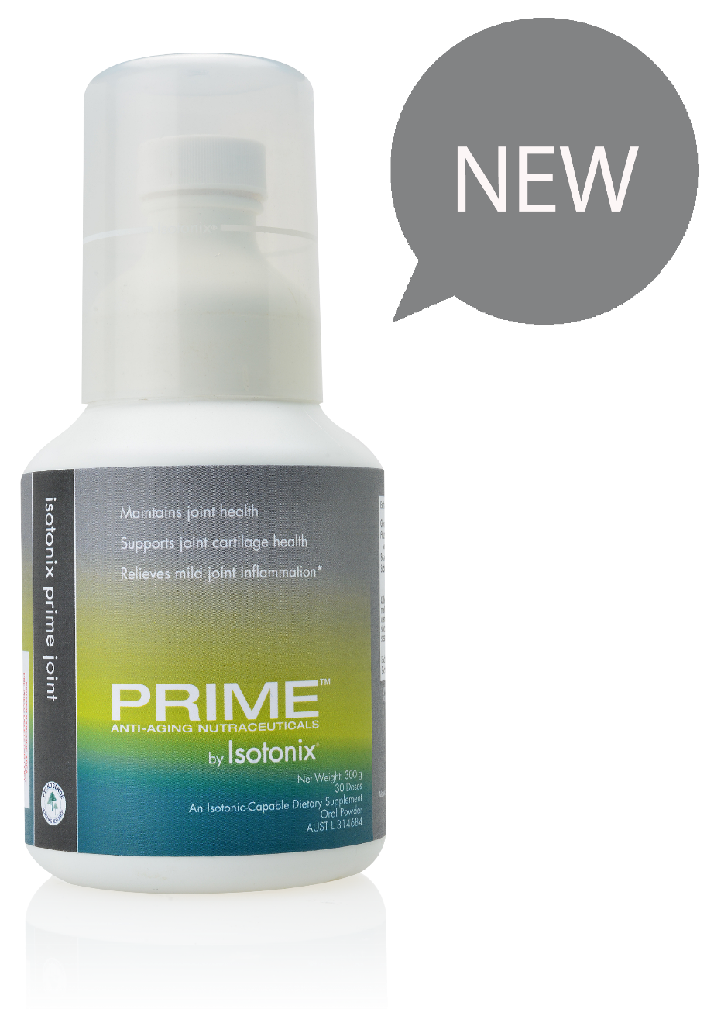
Product Code 713081 UnFranchise Cost $63.50 Suggested Retail $89.00 BV 42 Servings 30
ISOTONIX PRIME JOINT SUPPORT FORMULA
ISOTONIX PRIME JOINT | Gross MONTHLY Profit Per # of Customers Reordering Each Month
Number of Reorders | 10 | 25 | 50 | 100 | 250 | 500 | 1000 | 1500 | 3000
Profits AUD$ | 255 | 637.50 | 1,275 | 2,550 | 6,375 | 12,750 | 25,50 | 38,250 | 76,500

Slide 30
SOCIALISE WITH US
Please Take Advantage of our FREE Sales Aids
Available on UnFranchise.
Learn. Sell. Earn.
Notes:
Be sure to visit us at AU.SHOP.COM today and follow us on social media!
Like us. facebook.com/marketaustralia
Find us. instagram.com/marketaustralia
Visit us. AU.SHOP.COM and GLOBAL.SHOP.COM
Watch us. youtube.com/marketaustraliaTV

